Slide 1

Dr. Vithalrao Vikhe Patil College of Engineering, Ahmednagar
Department of Electrical Engineering
Project Review Stage: 2
On
TITAN 72V :Electrical Racing Battery Pack Using Smart BMS
By
Prathmesh R Gangode
Sanket B Fuge
Nikhil B Sase
Guided by
Prof. Miss S. K. Awaze
DEPARTMENT OF ELECTRICAL ENGINEERING
D.V.V.P. College OF Engineering,MIDC,
Vilad Ghat, PO- 414 111 Ahmednagar.

Slide 2
Dr. Vithalrao Vikhe Patil College of Engineering, Ahmednagar
Department of Electrical Engineering
Contents
Abstract
Introduction
Literature Survey
Problem Statement
Block Diagram
Objectives
Design & Methodology
Testing & Performance Evaluation
Conclusion
References (Research papers)

Slide 3
Abstract
This project focuses on the design and development of a 72V lithium-ion battery pack specifically intended for electric racing vehicles, where high energy density, high power output, and reliability are critical performance requirements. The battery pack is engineered to deliver rapid discharge capabilities, enabling the vehicle to achieve the acceleration and power demands associated with racing applications. To ensure safe and efficient operation under demanding conditions, the system incorporates advanced thermal management considerations that enhance thermal stability and minimize the risk of overheating.
A key feature of the battery pack is the integration of a Smart Battery Management System (BMS), which continuously monitors essential battery parameters, including cell voltage, current, temperature, and State of Charge (SOC). The BMS plays a vital role in maintaining battery health and operational safety by implementing protective mechanisms against overcharging, over-discharging, short circuits, and thermal runaway. Additionally, it performs cell balancing to ensure uniform charge distribution among cells, thereby improving overall battery efficiency, performance consistency, and lifespan. The developed 72V lithium-ion battery system provides a safe, efficient, and high-performance energy solution, making it highly suitable for modern electric racing vehicle applications.

Slide 4
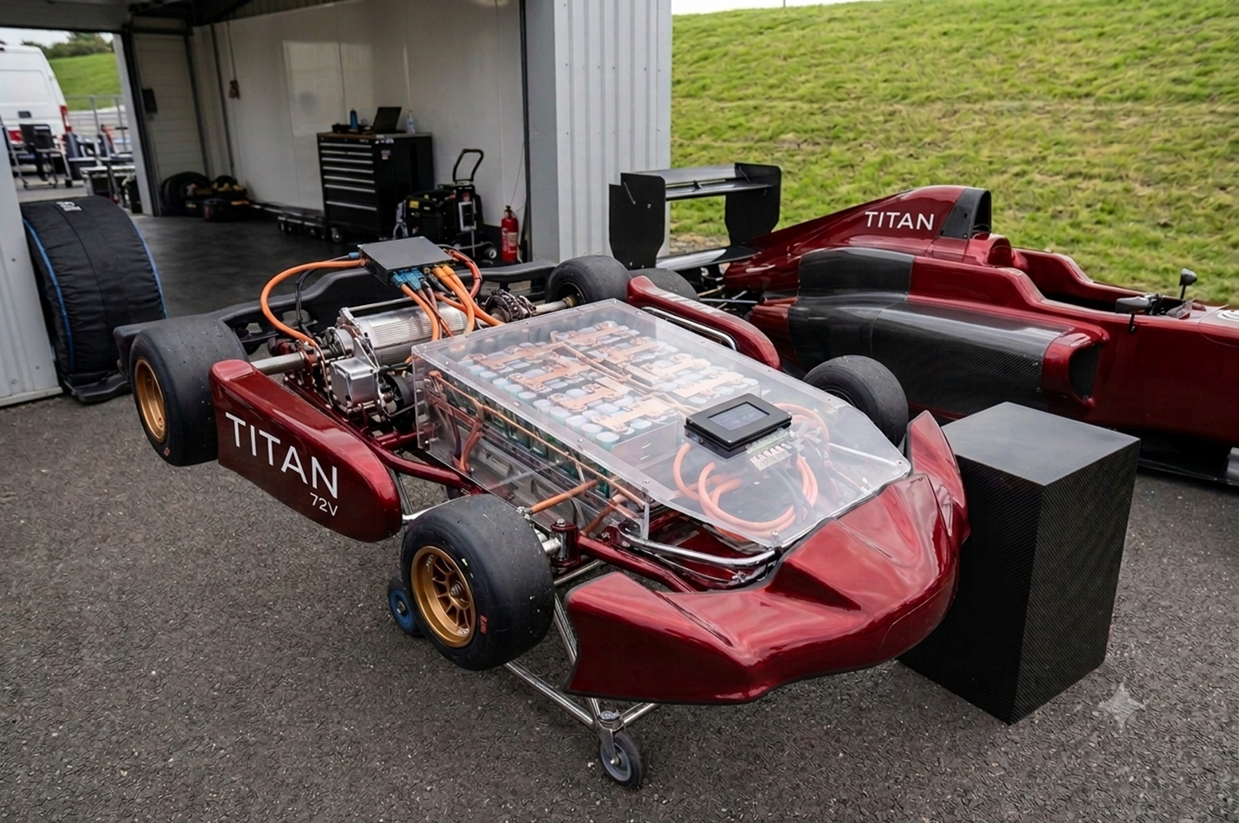
Introduction
1.Electric vehicles rely on high-performance battery packs as
their primary energy source.
2.In racing applications, lightweight, efficient, and safe
batteries are critical for performance.
3.Our project focuses on designing and understanding a
72V battery pack used in racing vehicles.
4.This project bridges theoretical knowledge and
practical implementation.

Slide 5
Literature survey
Dr. Vithalrao Vikhe Patil College of Engineering, Ahmednagar
Department of Electrical Engineering
Sr. No. | Author | Title of the paper | Publisher / Journal | Findings and Relevance | Methodology / Techniques Used | Remarks/Future scope
1. | Xiongbin Peng Akhil Garg Jian Zhang | Thermal Management System Design for Batteries Packs of Electric Vehicles: A Survey | Published by: IEEE (Institute of Electrical and Electronics Engineers) | The paper conducts a comprehensive survey of existing thermal management systems (TMS) for electric vehicle (EV) battery packs and compares three main strategi 1.Air cooling system 2.Liquid cooling system | Battery packs; Thermal Management; Active cooling; Temperature optimization | 1.Multi-objective Optimization of Battery Pack Variables 2. Battery Cell Uniformity and Equalization
2. | Niranjan Tarle Rishikesh Kulkarni Nainesh Desale | Design of a Battery Management System for Formula Student Electric Race Vehicle | Institute of Electrical and Electronics Engineers (IEEE | design and implementation of a Battery Management System (BMS) for a Formula Student Electric Vehicle (EV) Battery Pack Configuration: BMS Core Components: Measurement & Protection: PCB Design: Communication & Data Logging: | Battery management system (BMS), Electric Vehicles (EV), Formula Student (FS), Batteries. | The authors identify several potential areas for improvement and future research: Enhanced Reliability Testing: Integration with Advanced Algorithms:
3. | Haifei Long Zhigun Chen | Thermal management system design pure electric racing car power battery | IEEE (Institute of Electrical and Electronics Engineers)Published in 2017 at the ACEPT. | 1.Optimized Liquid Cooling System Design 2. Enhanced Thermal Uniformity 3. High Efficiency During Fast Charging & Discharging: 4. Simulation Validation: | Phase change heat dissipation; pure electric racing car power. | integration with Active Control Systems Lightweight & Compact Design

Slide 6


Problem Statement
EVs require efficient, safe, and high-performance battery packs,
Challenges: cell selection, thermal management, safety, and performance evaluation,
The challenge is to design and develop a 72V lithium-based battery pack integrated with a Smart Battery Management System (BMS) that ensures optimal power delivery, efficient cell balancing, advanced fault detection, and thermal management.

Slide 7
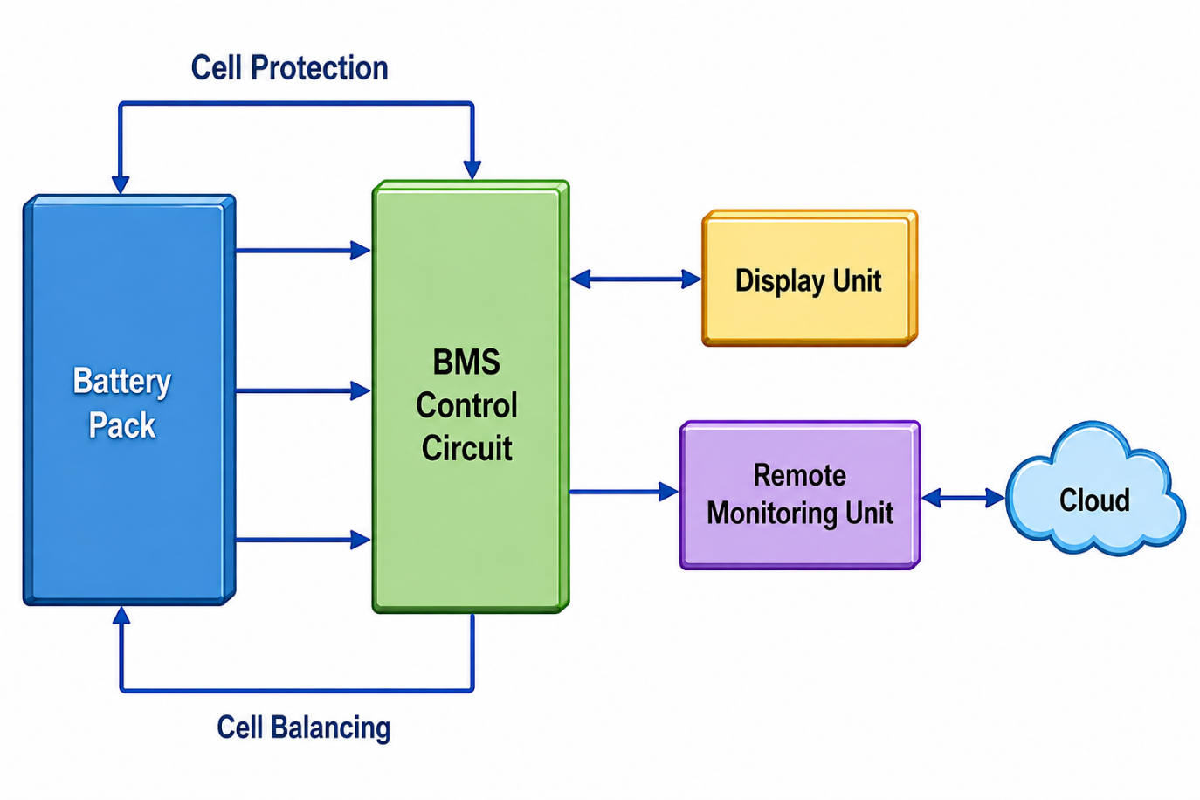
Block Diagram

Slide 8
Cell Characteristics
Parameter | Specification
Capacity (Typical) | 4500 mAh
Capacity (Minimum) | 4300 mAh
Charge Voltage | 4.2 V
Nominal Voltage | 3.6 V
Cell Weight | 70 g (Typical)
Standard Charge - Constant Current | 4.5 A
Standard Charge - Constant Voltage | 4.2 V
Standard Charge - Cut-off Current | 100 mA
Maximum Charge Current | 6.0 A
Discharge Cut-off Voltage | 2.5 V
Maximum Discharge Current (Continuous) | 45 A
Operating Temperature (Charge) | 0°C to 60°C
Operating Temperature (Discharge) | -40°C to 60°C

Slide 9
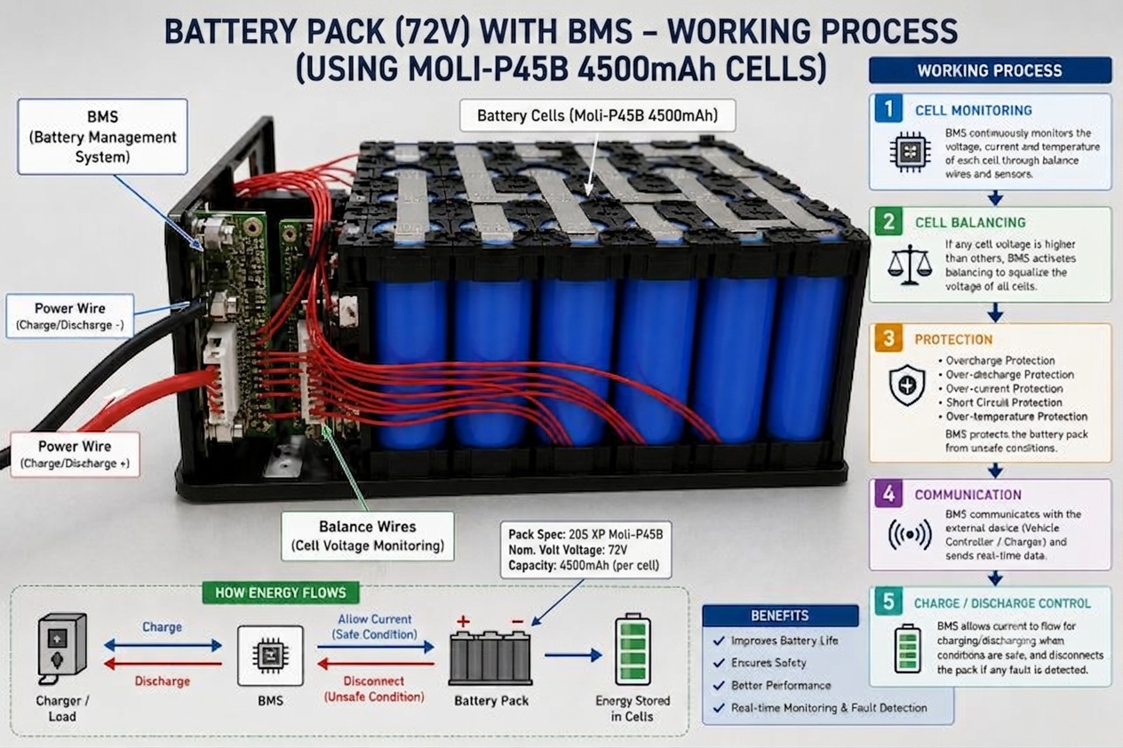
Working process

Slide 10
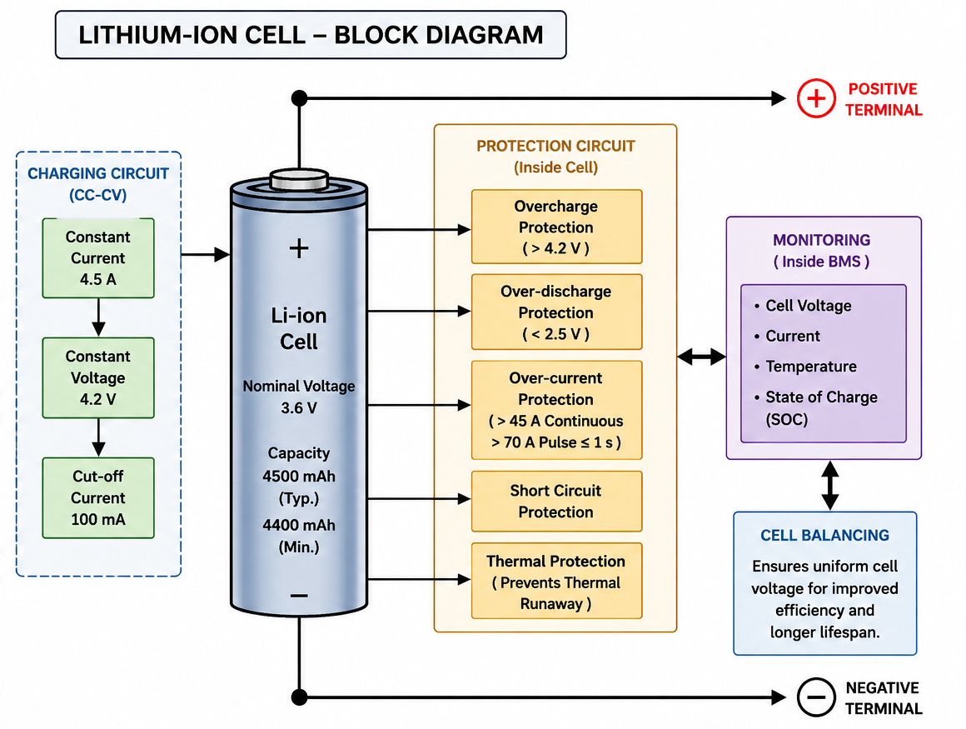
Block Diagram Of Cell

Slide 11
Design & Methodology
Cell Selection:
Chosen based on energy density, discharge rate (C-rate), safety, and cost.
Series-Parallel Configuration:
Series → to achieve 72V nominal voltage.
Parallel → to increase capacity & runtime.
Thermal & Safety Design:
Heat dissipation materials, vents, insulation.
Safety fuses and BMS for protection.
Assembly Process:
Mechanical structure design (modules + pack).
Proper insulation and connection welding.

Slide 12
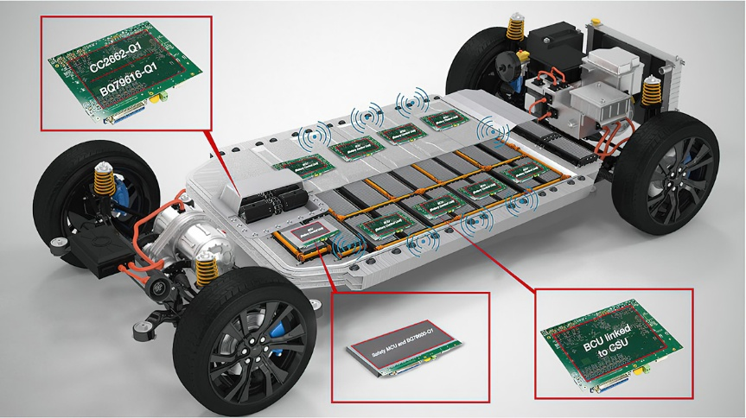
Objectives
Design
Design a reliable 72V battery pack architecture.
Learn
Learn cell selection and configuration methods.
Understand
Understand thermal and safety management in EV batteries.
Gain
Gain practical exposure to assembly and integration.
Perform
Perform testing and data analysis to evaluate performance.
Develop
Develop skills for future EV and energy storage applications.

Slide 13
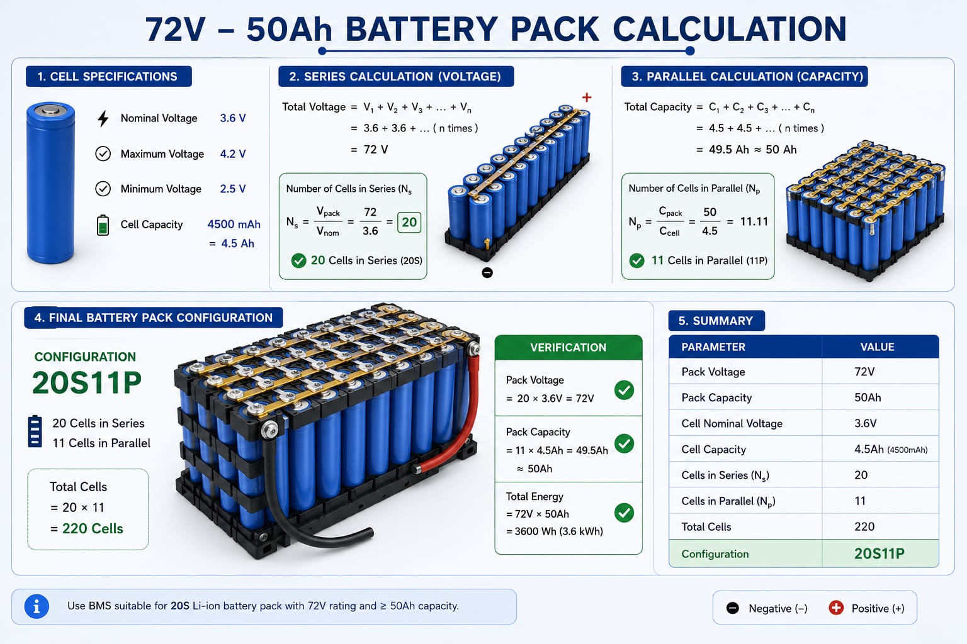

Slide 14
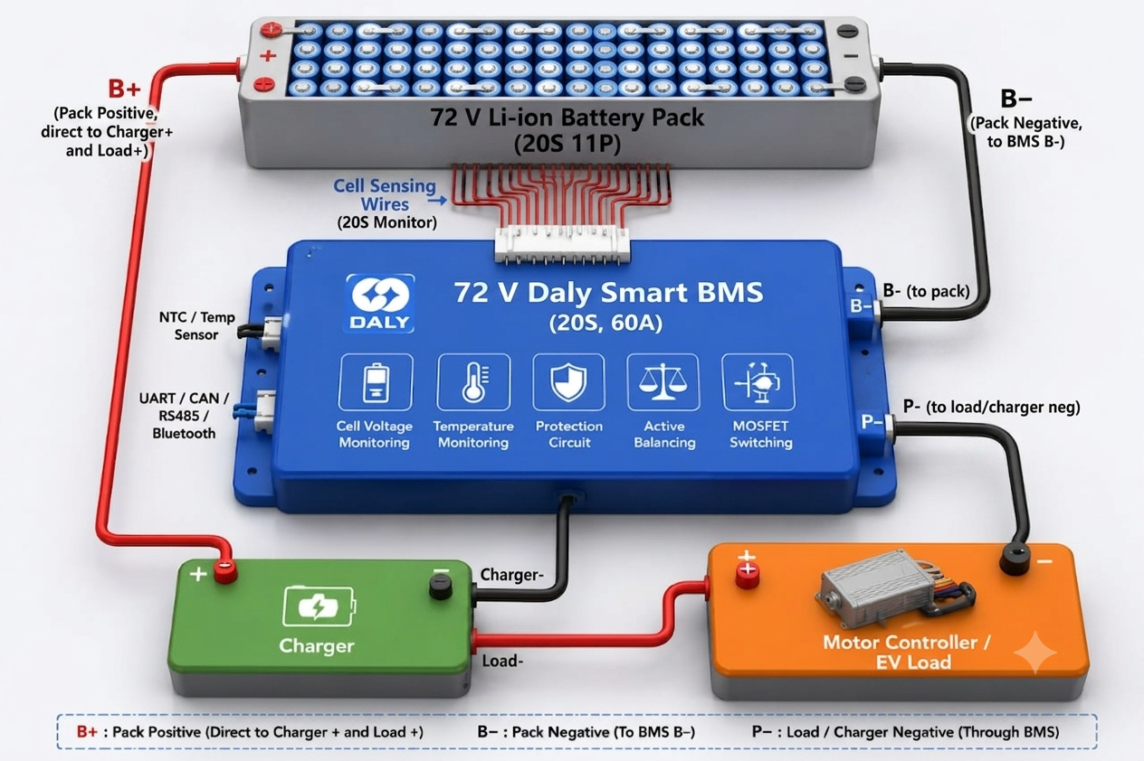
Daly Smart Active Balance BMS Connection Layout

Slide 15
Advantage and Disadvantages
Advantages
Real-Time Monitoring: Tracks individual cell voltages, pack temperature, and SoC/SoH via Bluetooth, app, or PC.
Intelligent Active Balancing: Dynamically transfers energy from high cells to low cells instead of wasting it as heat.
Customizable Safety Logic: Allows you to change protection thresholds (voltage, current, temperature cut-offs) via software.
Data Logging & Diagnostics: Records history and telemetry to help troubleshoot faults and predict battery life.
Disadvantages
Higher Cost: Significantly more expensive upfront due to microprocessors and advanced communication modules.
Higher Power Consumption: The Bluetooth, screen, and processors draw more idle/parasitic power from the battery pack.
Increased Complexity: More components and sophisticated integration mean more potential points of failure
Software Dependency: Relies heavily on stable firmware and apps; prone to bugs, glitches, or connection drops.

Slide 16
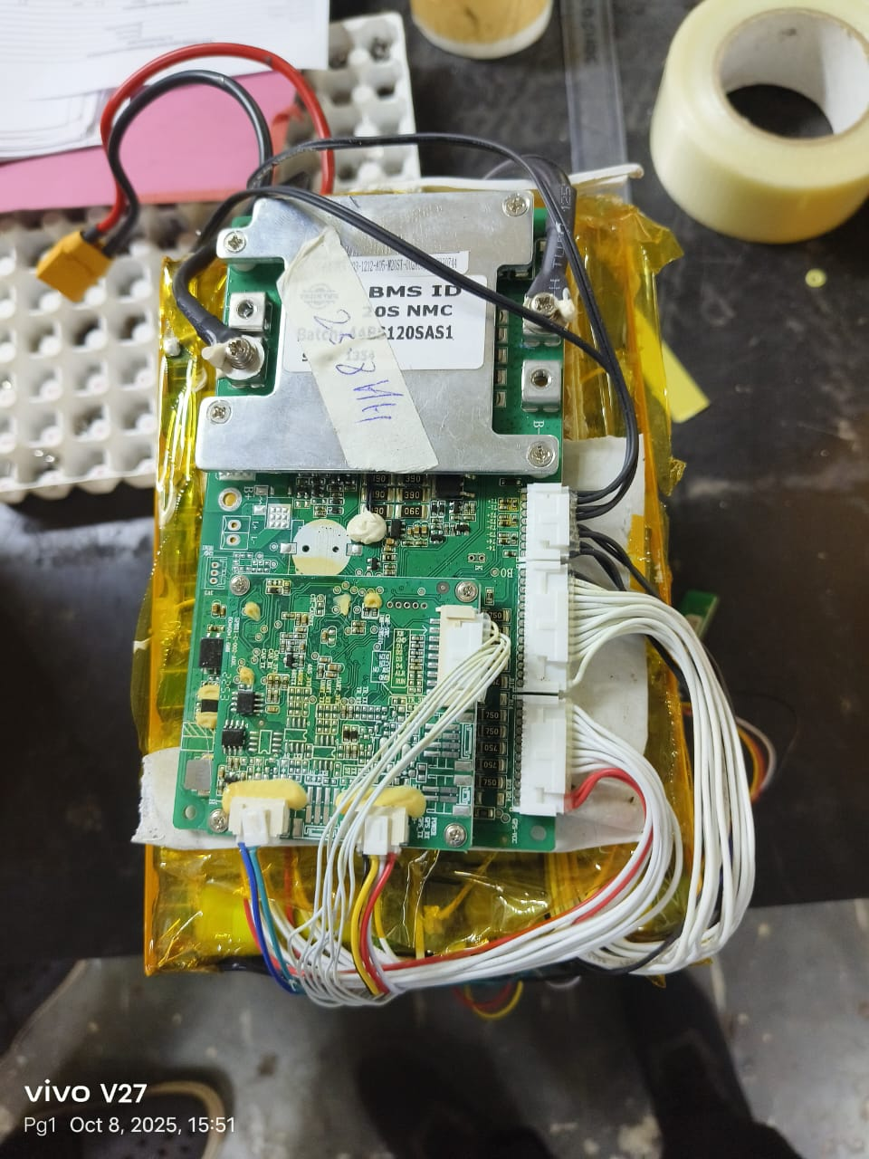
Battery Management System (BMS):
Monitors Continuously checks voltage, current, temperature of each cell.
Ensures safety against overcharging, over-discharging, and overheating.
Protection Features
Overvoltage protection (cell>4.2V).
Undervoltage protection (cell < 2.5V).
Overcurrent and short-circuit protection.
Thermal cutoff if temperature exceeds safe limits.
.

Slide 17
Cooling Methods:
Air Cooling (simpler, cheaper):
Fans or ducts blow air over the pack.
Used in small/medium power packs.
Liquid Cooling (advanced, efficient):
Coolant circulates through channels near cells.
Maintains tighter temperature control.
Common in racing and high-performance Ev’s.
For a 72V racing battery pack, liquid cooling is often preferred due to high discharge rates.
Cell Configuration: Multiple cells connected in series & parallel to achieve required voltage & capacity.

Slide 18

Cooling Method Used
Cold Plate Liquid Cooling:
Cold Plate Liquid Cooling is a battery cooling technique in which coolant flows through an aluminum cold plate placed near the battery cells. The coolant absorbs heat from the cells and transfers it to a radiator, helping maintain a safe operating temperature and improving battery performance.
Advantages
Efficient heat removal
Maintains uniform cell temperature
Improves battery life
Increases safety
Suitable for high-current and racing battery packs

Slide 19
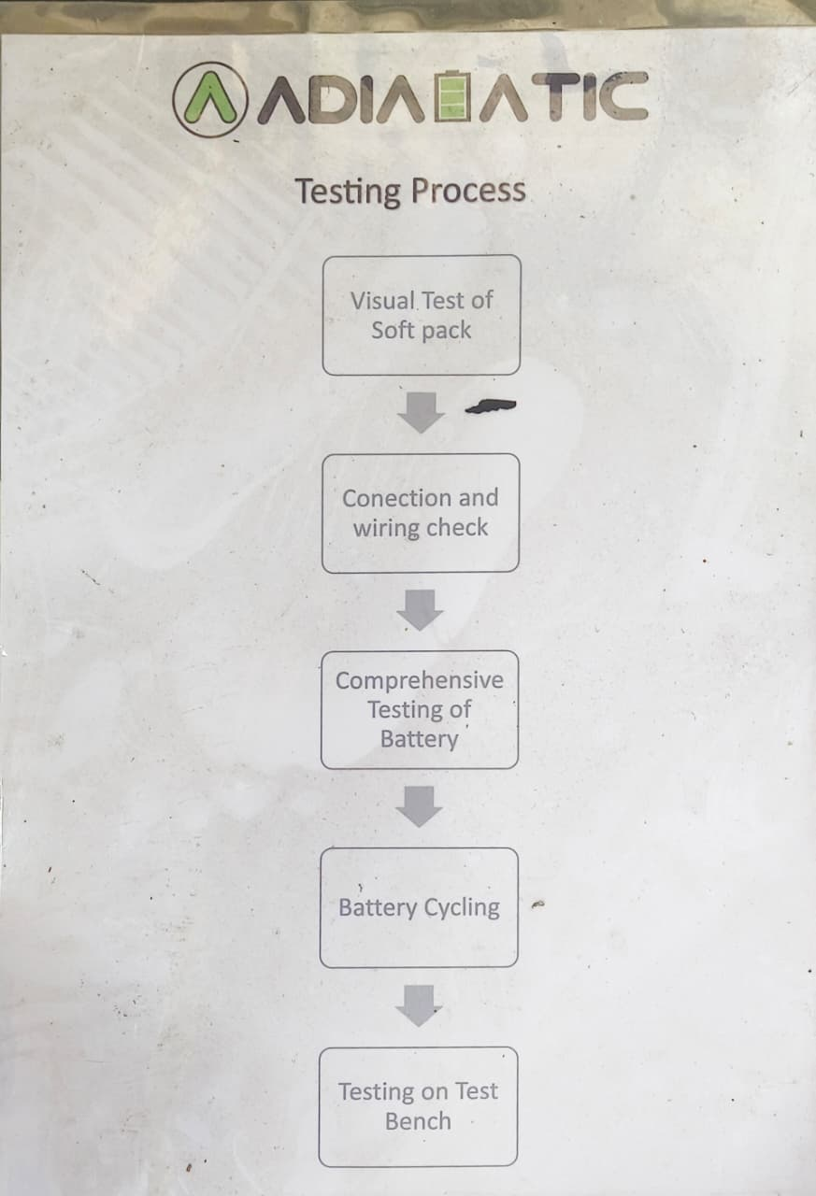
Testing & Performance Evaluation
Parameters Tested:
Voltage & capacity under load.
Charging/discharging efficiency.
Temperature rise during operation.
Observations must obtain:
Stable performance under racing loads.
BMS effectively manages safety.
Thermal management helps prevent overheating.
Software Used:
Battery again tester

Slide 20
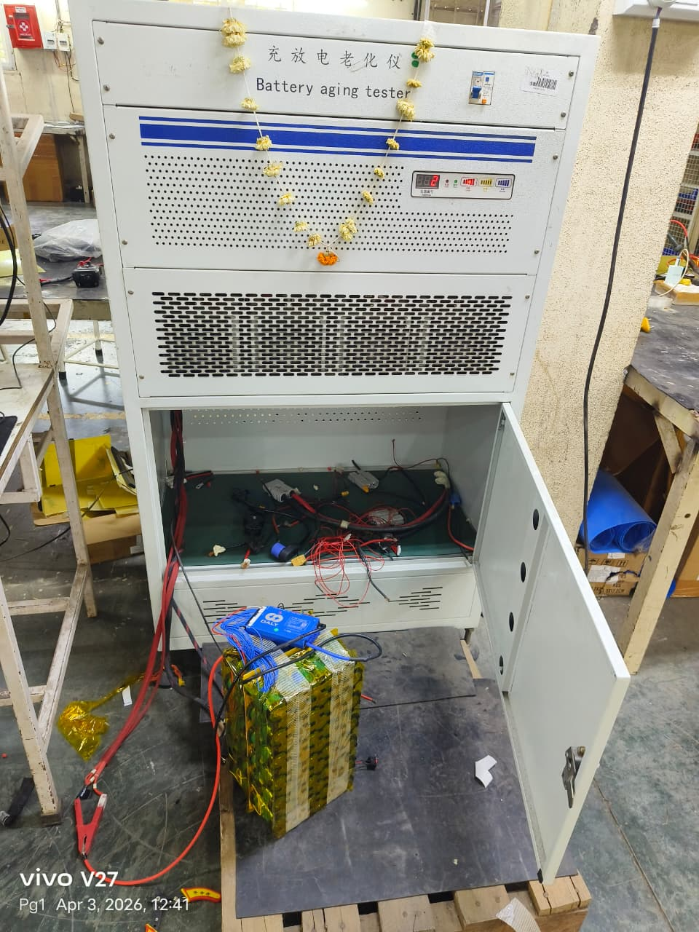
Battery Testing

Slide 21
Future Scope
Integration of advanced cooling systems for higher safety.
Use of solid-state batteries for improved energy density.
Development of smart BMS with IoT monitoring. Scaling design for commercial EV applications.

Slide 22

Conclusion
The project “TITAN 72V: Electrical Racing Battery Pack Using Smart BMS” enabled us to design and develop a high-performance, reliable, and safe battery pack for electric racing vehicles.
Furthermore, the project bridged the gap between theoretical concepts learned in the classroom and real-world engineering applications. It allowed us to apply engineering principles to solve practical challenges related to energy storage, battery protection, and vehicle performance.
Overall, this project provided a strong foundation for future careers in electric vehicles, battery systems, energy storage, and advanced automotive technologies. It strengthened our technical knowledge, problem-solving abilities, and confidence in working on innovative engineering projects.

Slide 23
References
N. Tarle, N. Desale, R. Kulkarni, and V. Pawar, “Design of a Battery Management System for Formula Student Electric Race Vehicle,” 2019 5th International Conference on Computing Communication Control and Automation (ICCUBEA), Pune, India, 2019, pp. 1–7. doi:10.1109/ICCUBEA47591.2019.9128526
X. Peng, A. Garg, J. Zhang, and L. Shui, “Thermal Management System Design for Batteries Packs of Electric Vehicles: A Survey,” 2017 IEEE International Conference on Applied System Innovation (ICASI/ACEPT), Sapporo, Japan, 2017, pp. 1–7. doi: 10.1109/ACEPT.2017.8168557.
S. Biswas, “Thermal Management System and Performance Characteristics of Electric Vehicle,” SAE Technical Paper 2020-28-0022, Aug. 2020. IEEE style reference
W. Shen and N. Wang, “Simulation and Control of Battery Thermal Management System for Electric Vehicle,” SAE Technical Paper 2022-01-7016, Mar. 31 2022. IEEE style reference:

Slide 24
Dr. Vithalrao Vikhe Patil College of Engineering, Ahmednagar
Department of Electrical Engineering
THANK YOU

